Slide 1

Introduction
David Quigley
CSCI 4622
2023 Spring

Slide 2
Monday

Slide 3
Course Logistics
Weekly Activity – Piazza Introduction
Due Wednesday, January 25 @ 11:15 AM (i.e. before class)
Weekly Activity – Syllabus Quiz
Due Monday, January 30 @ 11:15 AM
Problem Set 1 – releases today (?)
Due Monday, February 6 @ 11:59 PM (i.e. as late as possible)
This will move if it is not released today.
Orienting yourself to the syllabus, calendar, weekly modules, etc.

Slide 4
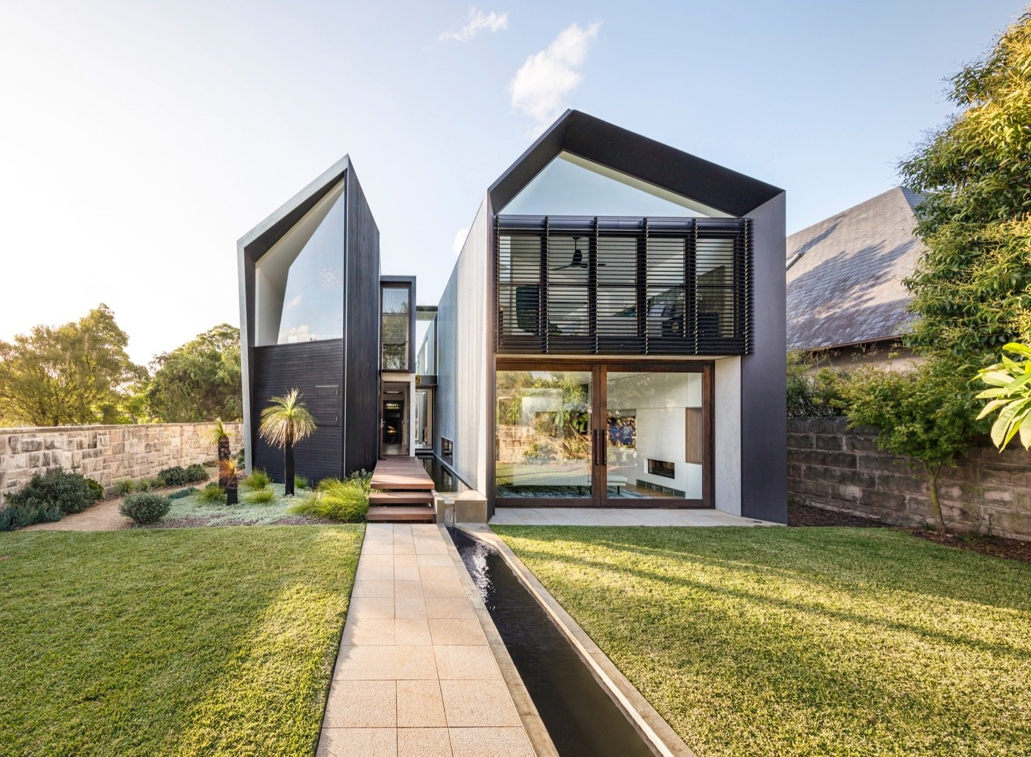
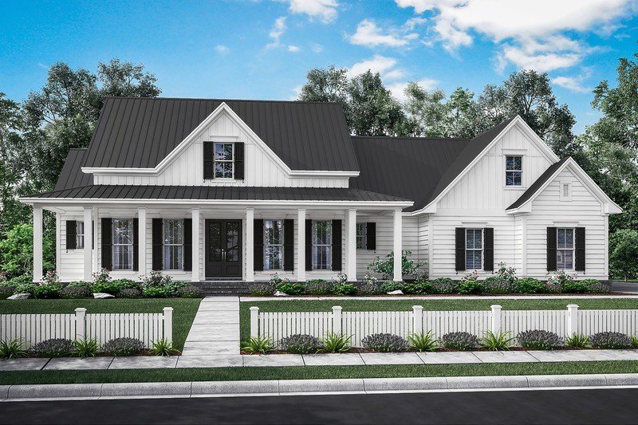
Problem Space – Housing Market
Notes:
https://cdn.houseplans.com/product/q5qkhirat4bcjrr4rpg9fk3q94/w800x533.jpg?v=8
https://images.dwell.com/photos/6328431439726800896/6445880622670512128/large.jpg

Slide 5
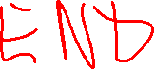
Problem Space – Housing Market
X₁ | X₂ | X₃ | X₄ | Y
Size (Sq. Ft.) | # Bed | # Bath | Year Built | Price ($)
1200 | 1 | 1.5 | 1998 | 200,000
1800 | 2 | 2 | 1985 | 450,000
800 | 1 | 1 | 2017 | 250,000
2500 | 3 | 2 | 1975 | 500,000
2800 | 4 | 2.5 | 1983 | 400,000
… | … | … | … | …

Slide 6
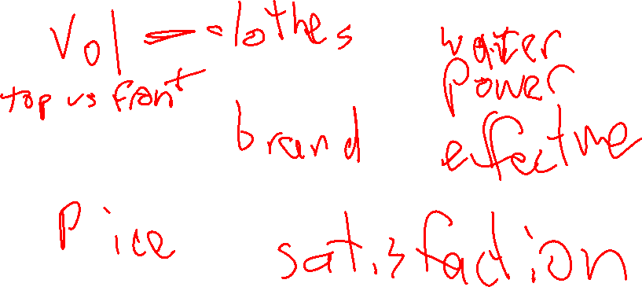
Problem Space: Washing Machines
X
Y

Slide 7
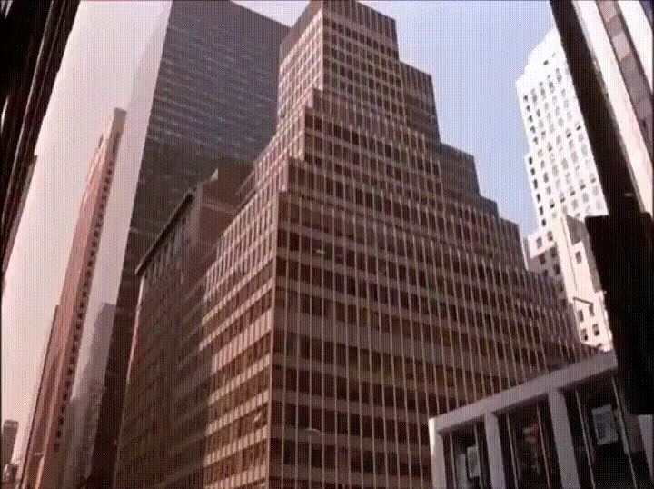
Problem Space – Washing Machines?
Notes:
https://www.reddit.com/r/ProgrammerHumor/comments/wtr52u/artificial_intelligence/

Slide 8
Supervised Learning
Find Patterns in fully observed data, then try to predict partially observed data.

Slide 9
Supervised Learning
Find Patterns in fully observed data, then try to predict partially observed data.
Approximate Z, as f = X → Y

Slide 10
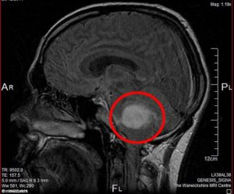
Supervised Learning
Find Patterns in fully observed data, then try to predict partially observed data.
Approximate Z, as f = X → Y
D = {(X_{i},Y_{i})}_{i=1→n}

Slide 11
Supervised Learning
Find Patterns in fully observed data, then try to predict partially observed data.
Approximate Z, as f = X → Y
D = {(X_{i},Y_{i})}_{i=1→n}
We are never able able to think about our predictions
as fact.

Slide 12

Unsupervised Learning
Find hidden structure in data that cannot be formally observed.
Discover Z
D = {(X_{i})}_{i=1→n}

Slide 13

Discrete Answer Space
y ∈ {1,2,…C} (i.e. Y is a “class”)
y = f(x) = argmax p(y = c | x, D)

Slide 14
Continuous Answer Space
y ∈ ℝ (i.e. Y is a Real number)

Slide 15

Problem Space – College Admissions
The following scenario isn’t really true, but it’s close to what we do in college admissions…
I am trying to decide if a student should be admitted to my university. I have their SAT and ACT scores and their HS GPA. I also have the history of students who have attended in the past, their SAT / ACT / HS GPA as well as whether or not they graduated from my university. I only want to admit new students if they will graduate.

Slide 16
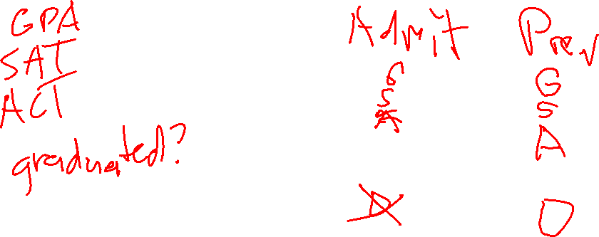
Problem Space – College Admissions
X_{i} =
Y =

Slide 17
My First ML Algorithm – K-Nearest Neighbors
Classifying a new / unknown student x:
Given my training set D, find the K students that are “nearest” to x and assign x to the label y held by the majority of those students.
What does “nearest” mean?

Slide 18
Prediction – College Admission
Student | SAT | ACT | GPA | Graduated?
A | 1200 | 26 | 3.2 | Yes
B | 1450 | 28 | 3.5 | Yes
C | 1000 | 20 | 3.0 | Yes
D | 730 | 15 | 2.0 | No
NEW | 720 | 16 | 2.2 | ???

Slide 19
Prediction – College Admission
Student | X₁ | X₂ | Y
A | 1200 | 26 | 1
B | 1450 | 28 | 1
C | 1000 | 20 | 1
D | 730 | 15 | -1
NEW | 720 | 16 | ???

Slide 20
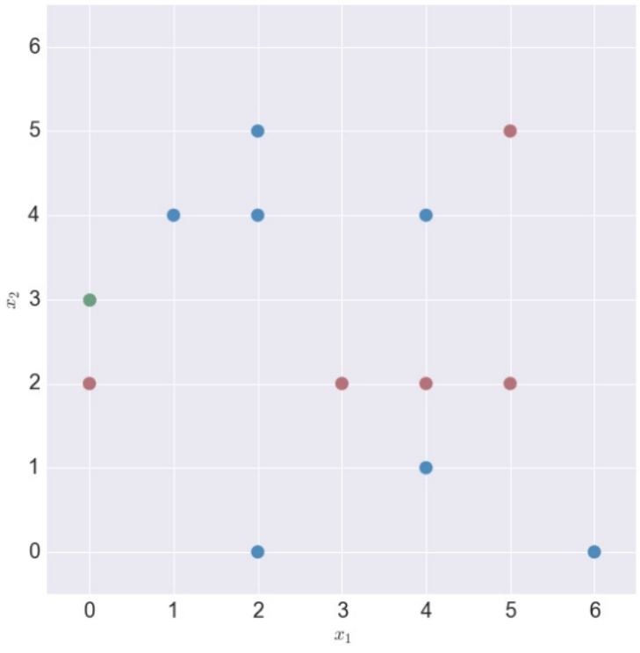
KNN – Which Point is Closest?

Slide 21
KNN – Manhattan/Taxicab Distance (L₁ Norm)
Manhattan Distance: ∑_{a=1…n}|x_{ia} – x_{a}|

Slide 22
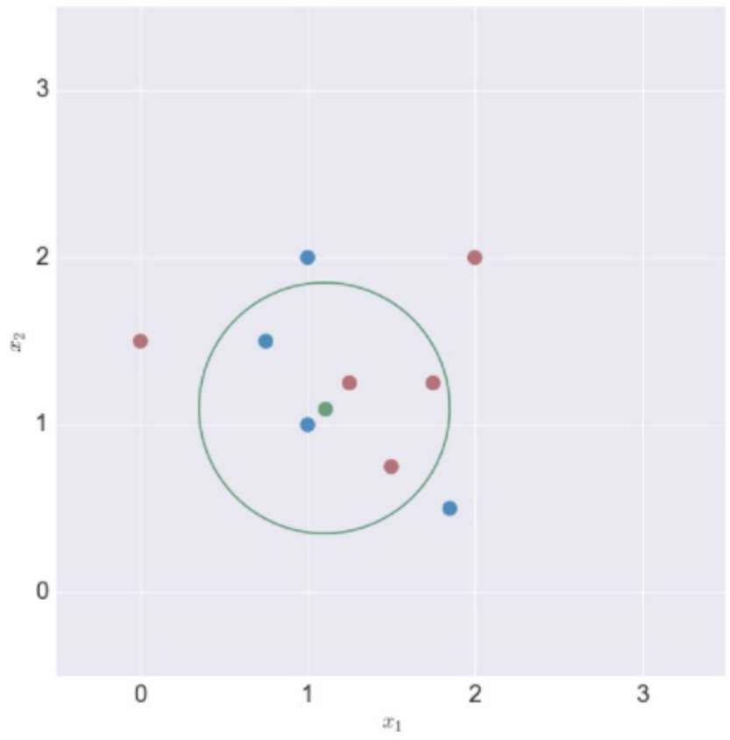
KNN – Euclidian Distance (L₂ Norm)
Euclidian Distance: ||x_{i} – x|| ²

Slide 23
KNN – Euclidian Distance (L₂ Norm)
Euclidian Distance: ||x_{i} – x|| ²

Slide 24
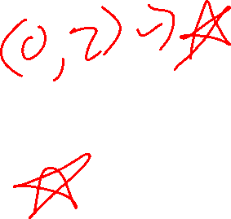
Find the Nearest Neighbors
K = 1, Point to classify at (0,3)
Nearest Neighbor
Prediction

Slide 25
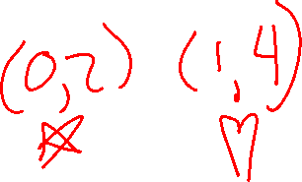
Find the Nearest Neighbors
K = 2
Nearest Neighbors
Prediction

Slide 26
Edge Case – K is even
This often messes up a K-Nearest Neighbors classification technique in a binary setting
What are you going to do?

Slide 27
Edge Case – K is even
This often messes up a K-Nearest Neighbors classification technique in a binary setting.
- Most common solution: K is an odd number

Slide 28
Edge Case – K is even
This often messes up a K-Nearest Neighbors classification technique in a binary setting.
- Most common solution: K is an odd number
(We’ll explore a case in a few minutes where this may not generalize)
- A safety net: Set up defaults if there’s a tie
- A common default: Whichever case is more common
- An ethical consideration: Whichever case is safer / more ethical

Slide 29
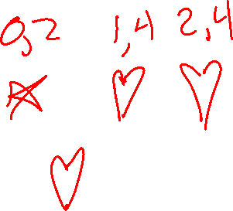
Find the Nearest Neighbors
K = 3
Nearest Neighbors
Prediction

Slide 30
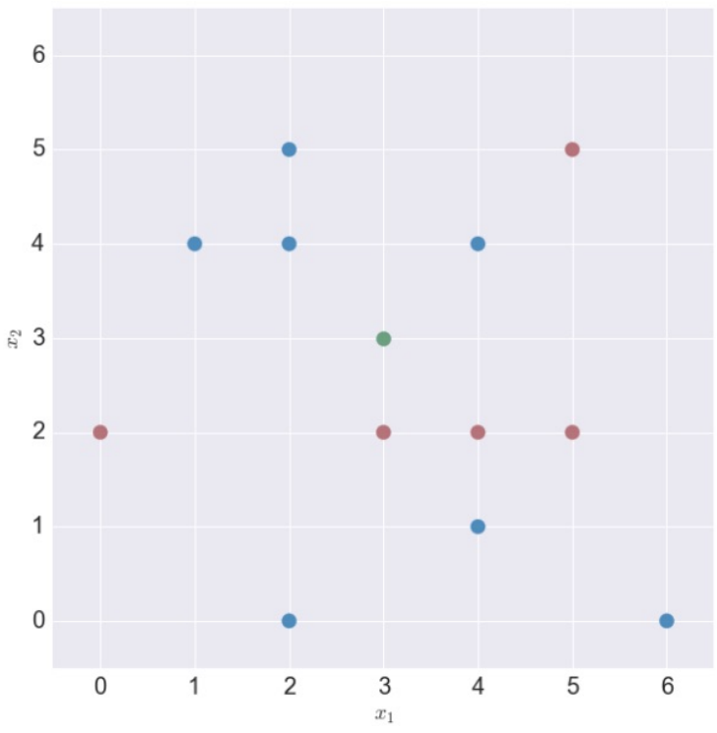
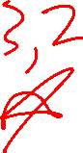
Find the Nearest Neighbors
K = 3
Nearest Neighbors
Prediction

Slide 31
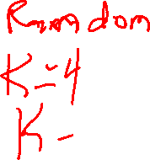
Edge Case – Multiple cases equidistant
Sometimes you’re looking for, say, the 3 nearest neighbors, but you end up finding there are 2 or 3 equally distant neighbors at that 3rd nearest distance.
What are you going to do?

Slide 32
Edge Case – Multiple cases equidistant
Sometimes you’re looking for, say, the 3 nearest neighbors, but you end up finding there are 2 or 3 equally distant neighbors at that 3rd nearest distance.
Easiest answer: Whichever one you encounter first in memory!
Other answers
Allow your K to be flexible
Will your answer change at K = 4 or K = 5?
Fall back on a default rule

Slide 33
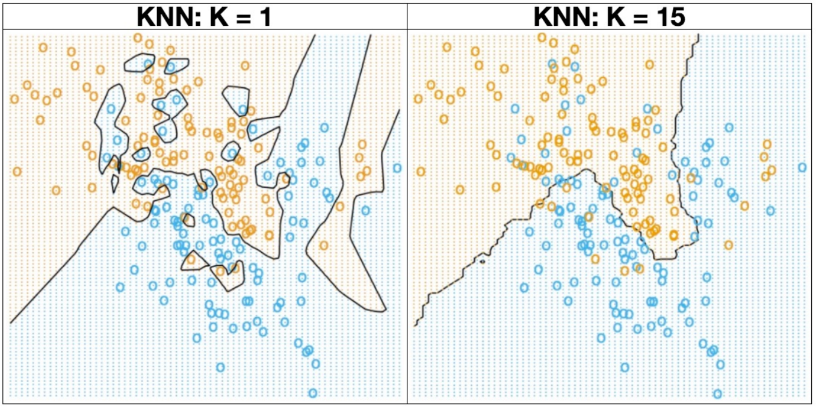
My First ML Algorithm – KNN

Slide 34
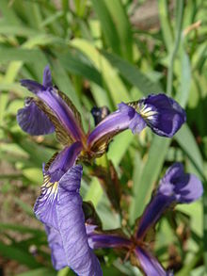
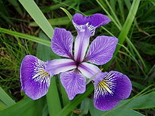
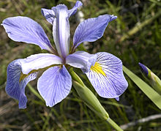
KNN – Beyond Binary Decisions
Iris Classification
Iris Setosa
Iris Versicolor Iris Virginica
https://en.wikipedia.org/wiki/Iris_flower_data_set

Slide 35
KNN – Beyond Binary Decisions
What are some questions / issues / considerations you see arising in this problem space?
https://en.wikipedia.org/wiki/Iris_flower_data_set

Slide 36
KNN – Beyond Binary Decisions
What if the “label” Y we are assigning is not a “class”…

Slide 37
KNN – Beyond Binary Decisions
What if the “label” Y we are assigning is not a “class”…
But is a numeric value?
0.8
1.7
0.4
0.6
1.2
-2.1
-0.1
0.2
0.6
-0.5
-1.5
-0.6

Slide 38
KNN – Beyond Binary Decisions
What if the “label” Y we are assigning is not a “class”…
But is a numeric value?
Find K neighboring points and find the average of their Y values!
0.8
1.7
0.4
0.6
1.2
-2.1
-0.1
0.2
0.6
-0.5
-1.5
-0.6

Slide 39
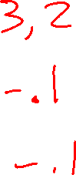
KNN – Beyond Binary Decisions
K = 1, Point to regress at (3,3)
Nearest Neighbor
Prediction
0.8
1.7
0.4
0.6
1.2
-2.1
-0.1
0.2
0.6
-0.5
-1.5
-0.6

Slide 40
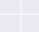
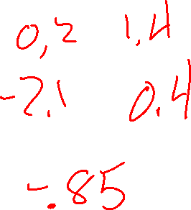
KNN – Beyond Binary Decisions
K = 2, Point to regress at (0,3)
Nearest Neighbor
Prediction
0.8
1.7
0.4
0.6
1.2
-2.1
-0.1
0.2
0.6
-0.5
-1.5
-0.6

Slide 41
KNN – Beyond Binary Decisions
K = 2, Point to regress at (0,3)
Since it is no longer a voting scheme, we no longer worry about ties!
0.8
1.7
0.4
0.6
1.2
-2.1
-0.1
0.2
0.6
-0.5
-1.5
-0.6

Slide 42
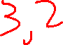
KNN – Beyond Binary Decisions
K = 2, Point to regress at (3,3)
Nearest Neighbor
Prediction
0.8
1.7
0.4
0.6
1.2
-2.1
-0.1
0.2
0.6
-0.5
-1.5
-0.6

Slide 43
KNN – Beyond Binary Decisions
K = 2, Point to regress at (0,3)
We still have an equidistance problem!
But is it a problem?
0.8
1.7
0.4
0.6
1.2
-2.1
-0.1
0.2
0.6
-0.5
-1.5
-0.6

Slide 44
Edge Case – Multiple cases equidistant
Sometimes you’re looking for, say, the 3 nearest neighbors, but you end up finding there are 2 or 3 equally distant neighbors at that 3rd nearest distance.
Easiest answer: Whichever one you encounter first in memory!
Other answers
Allow your K to be flexible
Will your answer change at K = 4 or K = 5?
Fall back on a default rule

Slide 45

How do we know if it works?

